Slide 1

What to search today?
Welcome to Sophia’s Path:
An Interactive Journey Through the History of Philosophy
Dive into the world of philosophical thought with Sophia’s Path, where wisdom branches out in new and engaging ways. This unique platform presents the history of philosophy through an interactive tree map, allowing you to explore the development of ideas, schools of thought, and the connections between great philosophers.
Join us on this journey, where the exploration of ideas is as dynamic as the thinkers themselves. Discover the connections, uncover new insights, and immerse yourself in the timeless pursuit of knowledge.

Slide 2

What to search today?
Sophia’s Path is Interactive
At Sophia’s Path, wisdom isn’t static—it’s a living, breathing network of ideas. Every philosopher and every theory is part of a broader conversation spanning centuries. Whether you’re a curious beginner or an experienced philosopher, this site provides a comprehensive and interactive way to navigate the complex landscape of philosophy, with both depth and clarity.

Slide 3

What to search today?
Go through Sophia’s Path along tree nodes
Each philosophical school/ philosopher is a node on the map, and with just a click, you can uncover its core theories and their contributions to the world of philosophy.

Slide 4
What to search today?
Medieval Philosophy
Post-Modern Philosophy
Development and
Negation
Analytic Philosophy
Ancient Philosophy
…
…
TIMELINE

Slide 5
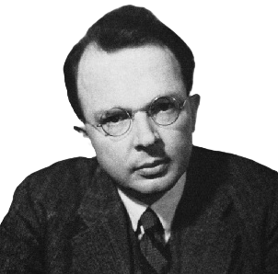

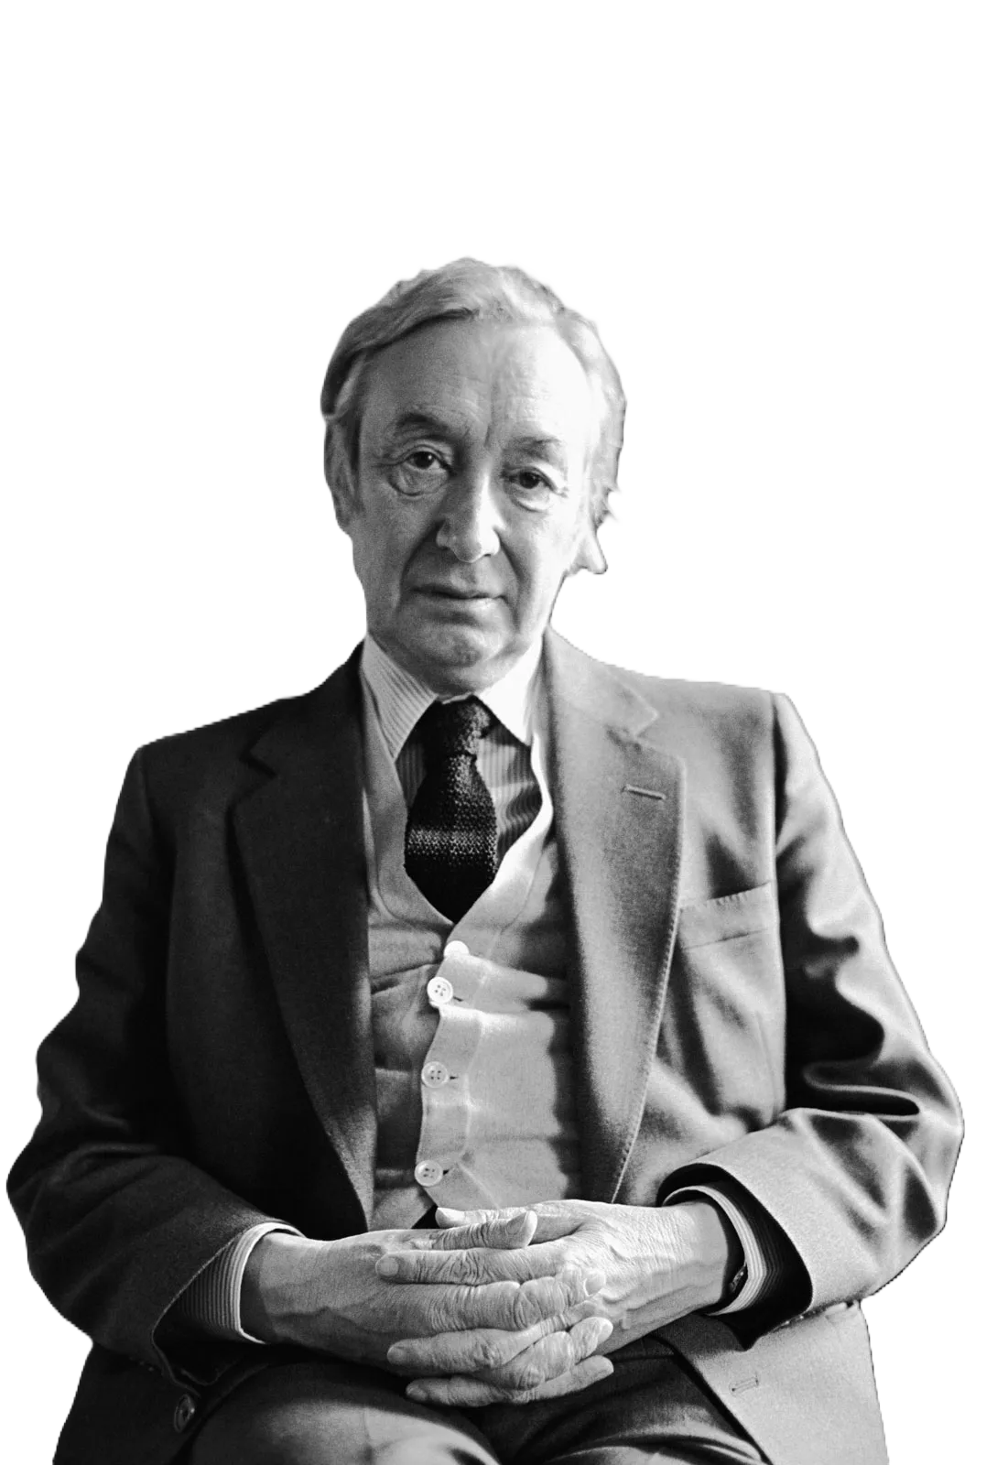
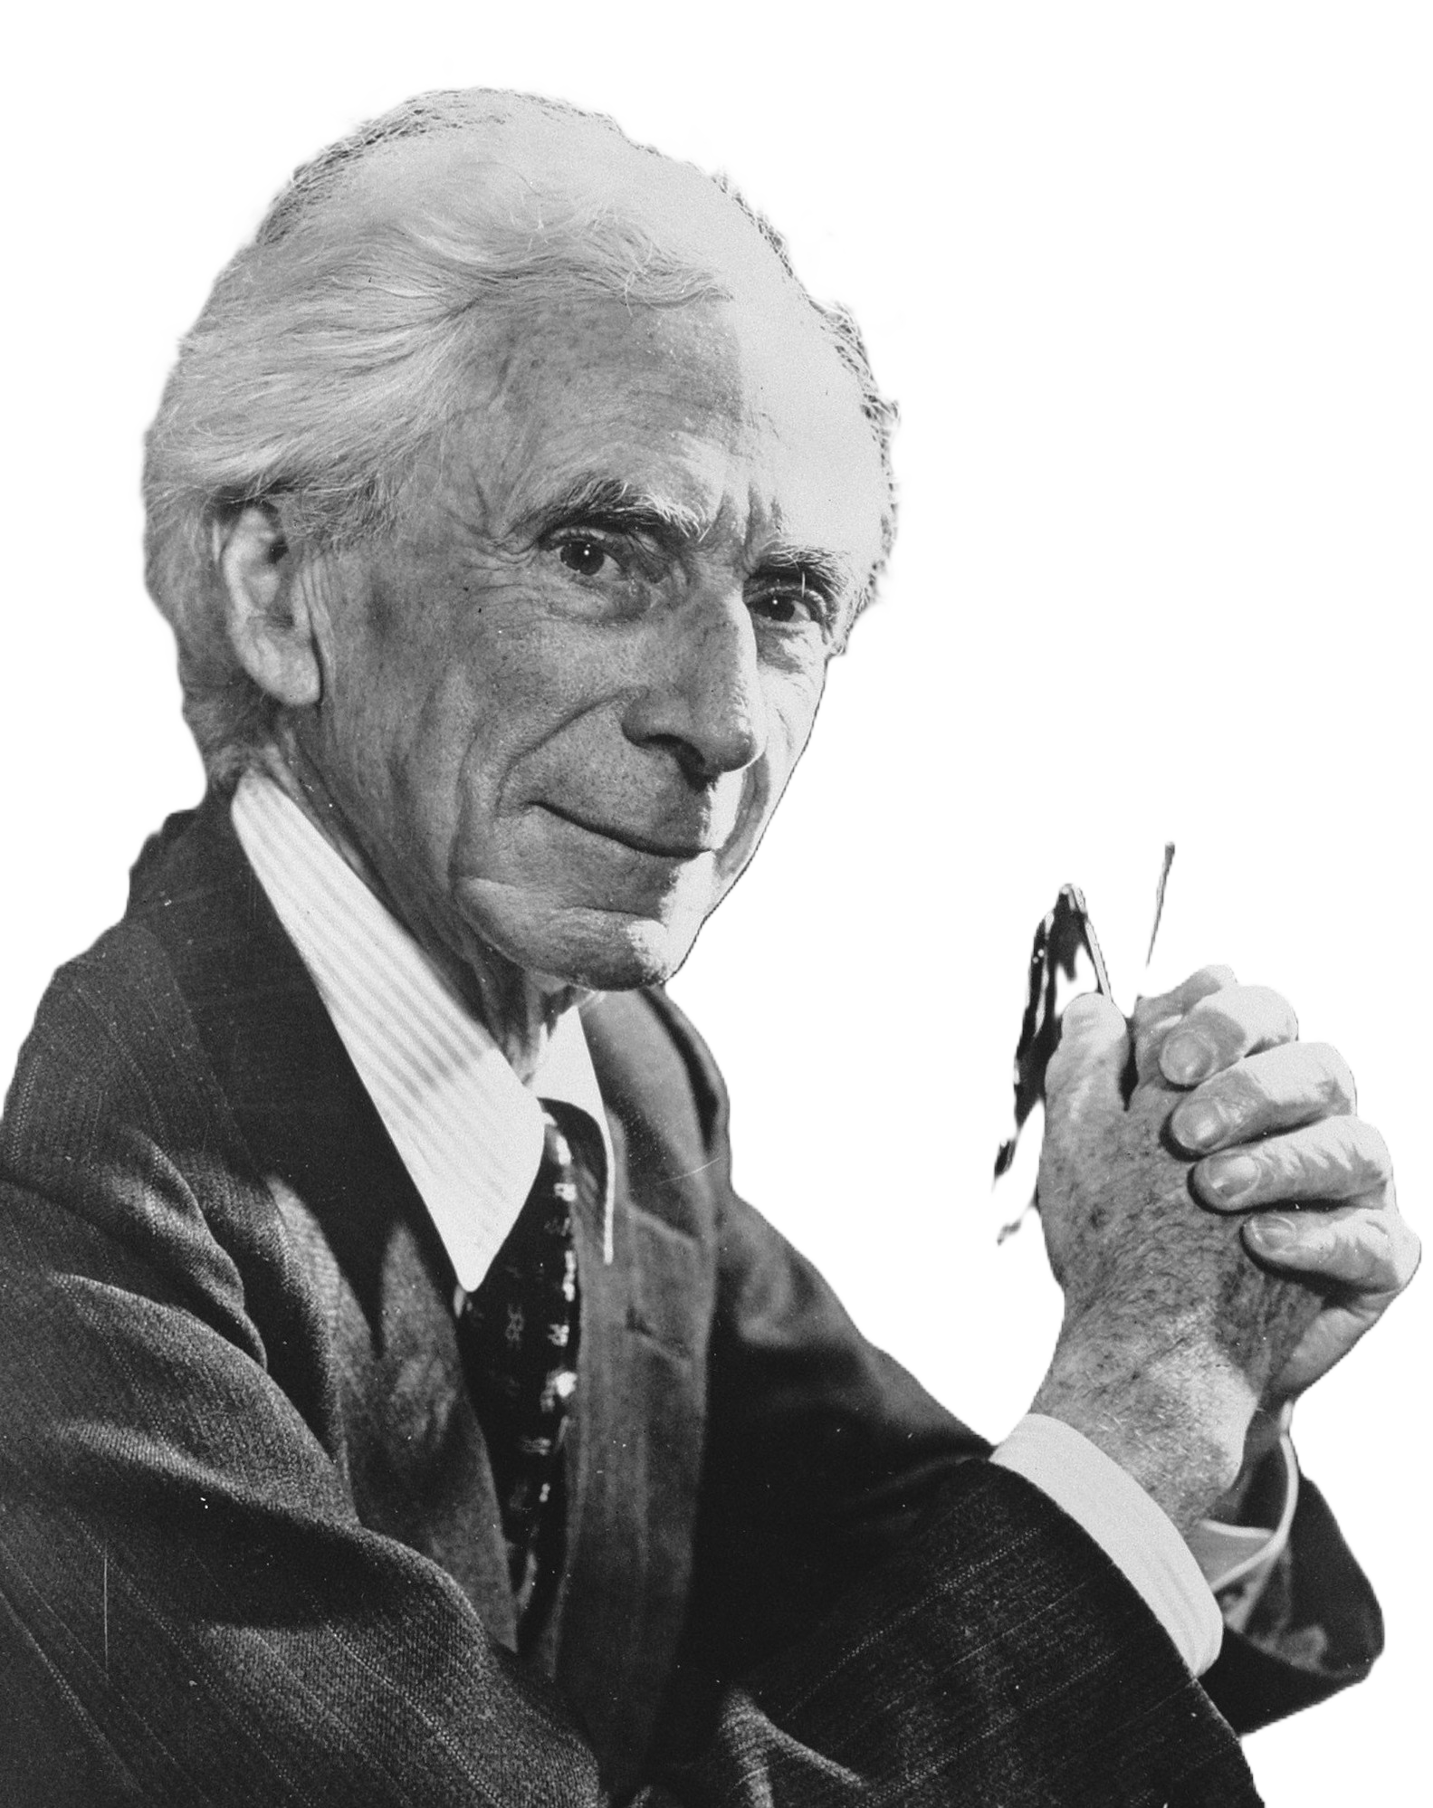
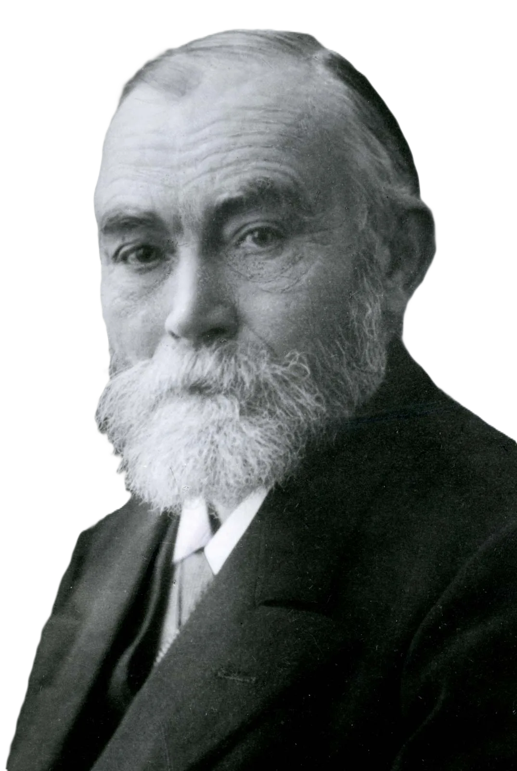
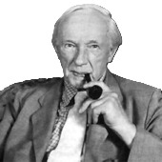
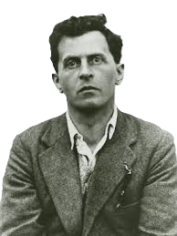

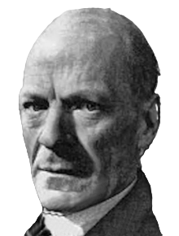
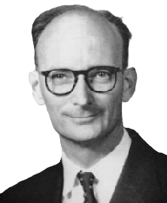
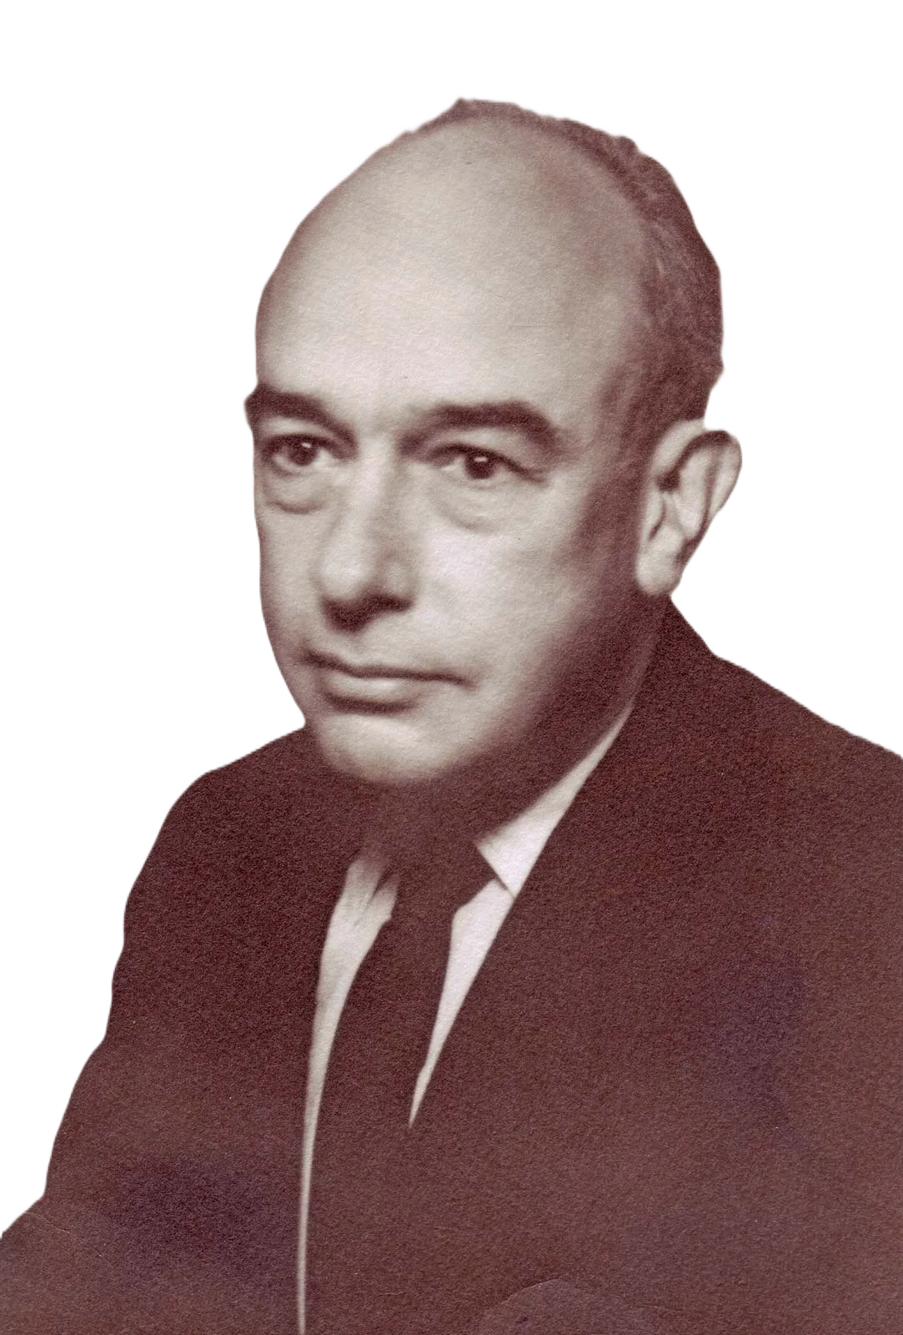
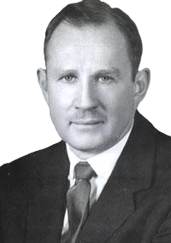
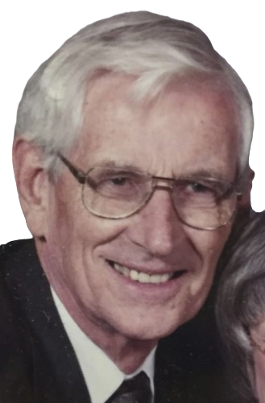
What to search today?
Logical Positivism
Filter
Objection
Metaphysics
Logical Atomism
Vienna Circle
Epistemology
Rudolf Carnap
Objection
Ethics
A. J. Ayer
Philosophy of Mind
Bertrand Russell
Gottlob Frege
Political Philosophy
Influence
Emergence of Ordinary Language Philosophy
G. E. Moore
Ludwig Wittgenstein
P. F. Strawson
Gilbert Ryle
J. L. Austin
Logical Empiricism and its End
Willard Von Orman Quine
Wilfrid Sellars
Roderick Chisholm
TIMELINE

Slide 6
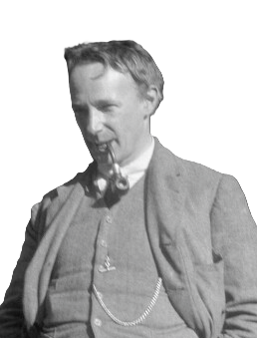
George Edward Moore
The Refutation of Idealism and the proof of the external world
Against the Idealist notion that to be is to be perceived, the central idea of Moore´s counterargument is that external objects are things whose existence is not dependent upon our experience. This is the distinction of consciousness and the content of our consciousness. To prove their existence, Moore holds up his two hands and states, "Here is one hand" while making a gesture with his right hand, and then adds, " and here is another" while making a gesture with his left hand. He argues that this simple demonstration provides a perfectly rigorous proof of the existence of external objects. Moore's aim is to establish the existence of an external world, rather than proving his knowledge of it.
Principia Ethica
I.Anti-naturalistic view: In Principia Ethica, G.E. Moore introduces the famous "naturalistic fallacy," which states that it is a mistake to define goodness in terms of natural properties such as pleasure or desire. In this sense, goodness is an indefinable and irreducible concept. Moore holds the view that ethical questions cannot be answered solely by appealing to natural facts or scientific knowledge.
II. Consequentialist account of ethics: the right action is determined by its ability to produce the best outcome. The ultimate goal of ethics, Moore argued, is to maximize intrinsic value, which is the fundamental type of ethical value.
…….

